Slide 1
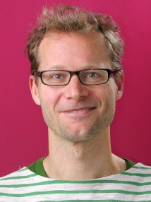
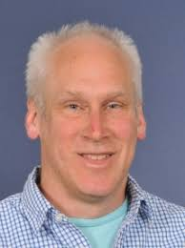
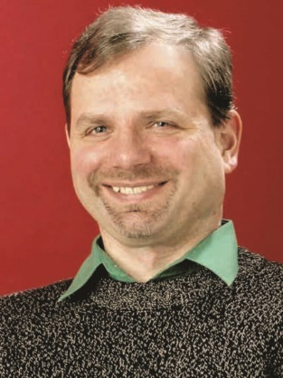
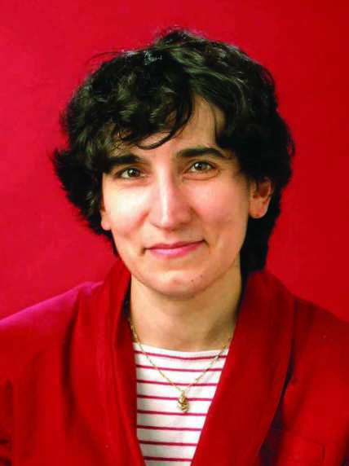
PG welfare in Physics: PhD
(Profs Lesley Cohen, Ji-Seon Kim or Dr Yvonne Unruh if you’d prefer to talk to a female member of staff)

Slide 2
Highlights
Student-supervisor agreement: https://www.imperial.ac.uk/physics/students/current-students/postgraduate-research/postgraduate-student-handbook/guidance-for-students/
Student well being advice team (SWAT) & Student mental health intervention officers (concernedaboutastudent@imperial.ac.uk)

