Slide 1
Multimodal prediction of Alzheimer’s disease – opportunities in Nordic registry and biobank data
Ole A. Andreassen
NORMENT Centre, Division of Mental Health and Addiction, Oslo University Hospital Institute of Clinical Medicine, University of Oslo
Email: ole.andreassen@medisin.uio.no

Slide 2
Precision Psychiatry
Prediction
Stratification
NeuroPsych

Slide 3
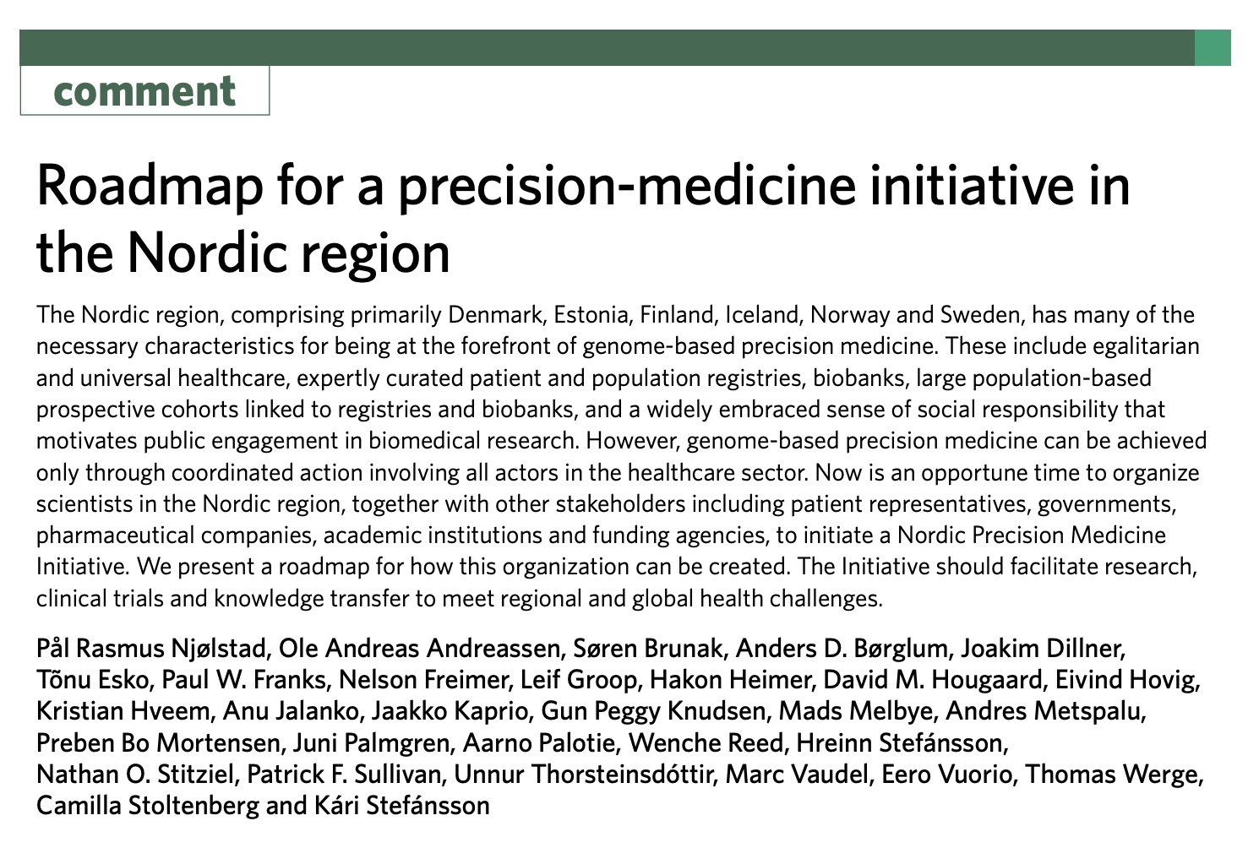

Slide 4
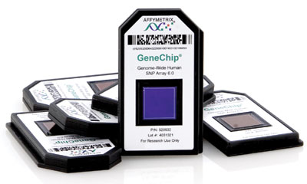
Genetic ‘revolution’
Reduced genotyping costs – massive genotyped samples
  Polygenic architecture
  Multiple small effects
«Genotyping your DNA is cheaper than parking at the hospital»

Slide 5
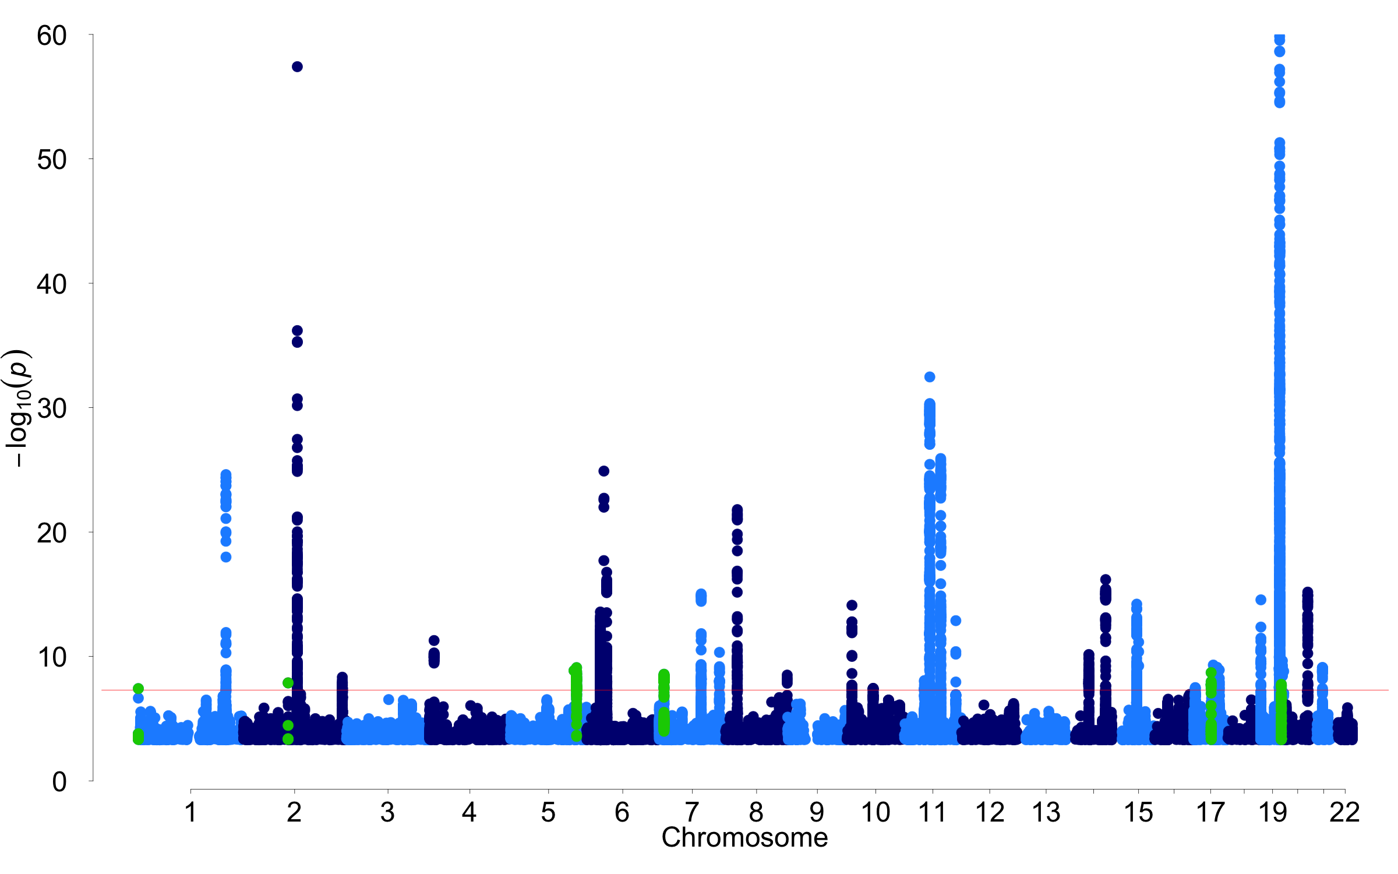
2021: Alzheimer’s disease - 38 loci
Wightman et al. Nat Genet 2021

Slide 6
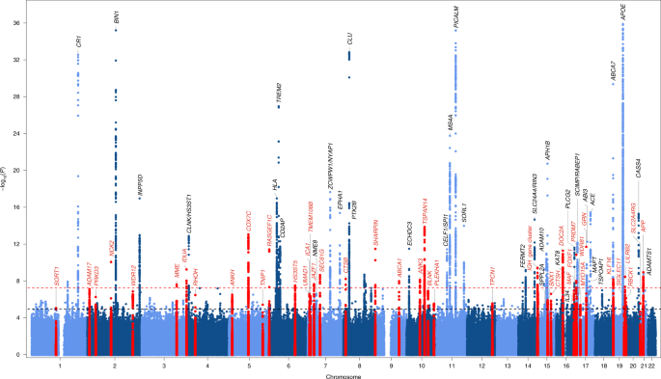
2022: Alzheimer’s disease
75 variants – mixed ‘polygenic’
Bellenguez et al Nat Genet 2022

Slide 7
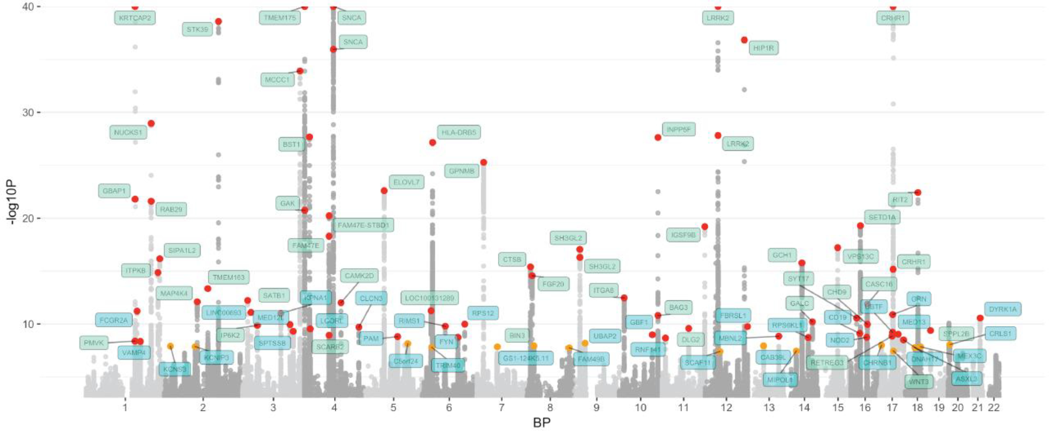
2019: Parkinson’s disease - 90 loci
75 variants – mixed ‘polygenic’
Nalls et al. Lancet Neurol 2019

Slide 8
Impact
How can recent genetic discoveries be clinically helpful?

Slide 9
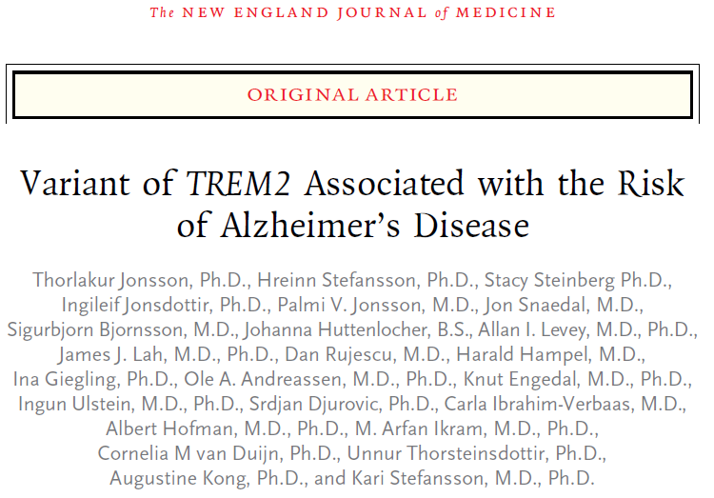

Slide 10
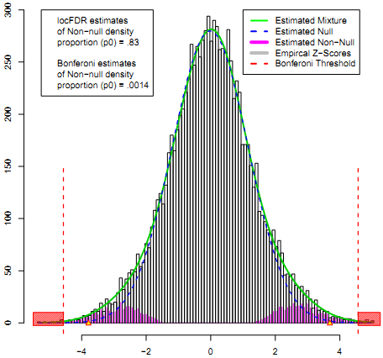
Analytical approach
Standard tools LDSR, GCTA etc
  Infinitesimal model:
  all markers have an effect, (Fisher 1918)
MiXeR
Mixture models
  Null and non-null effects
Mixed effect directions
  Both same and opposite directions

Slide 11
Prediction
Identify individuals at risk late-onset Alzheimer’s disease (AD) – too late if memory loss
GWAS have identified several variants associated with AD beyond APOE ε4
Supervised machine learning
When, not if
  not case-control but age of onset
  polygenic hazard score (PHS)

Slide 12
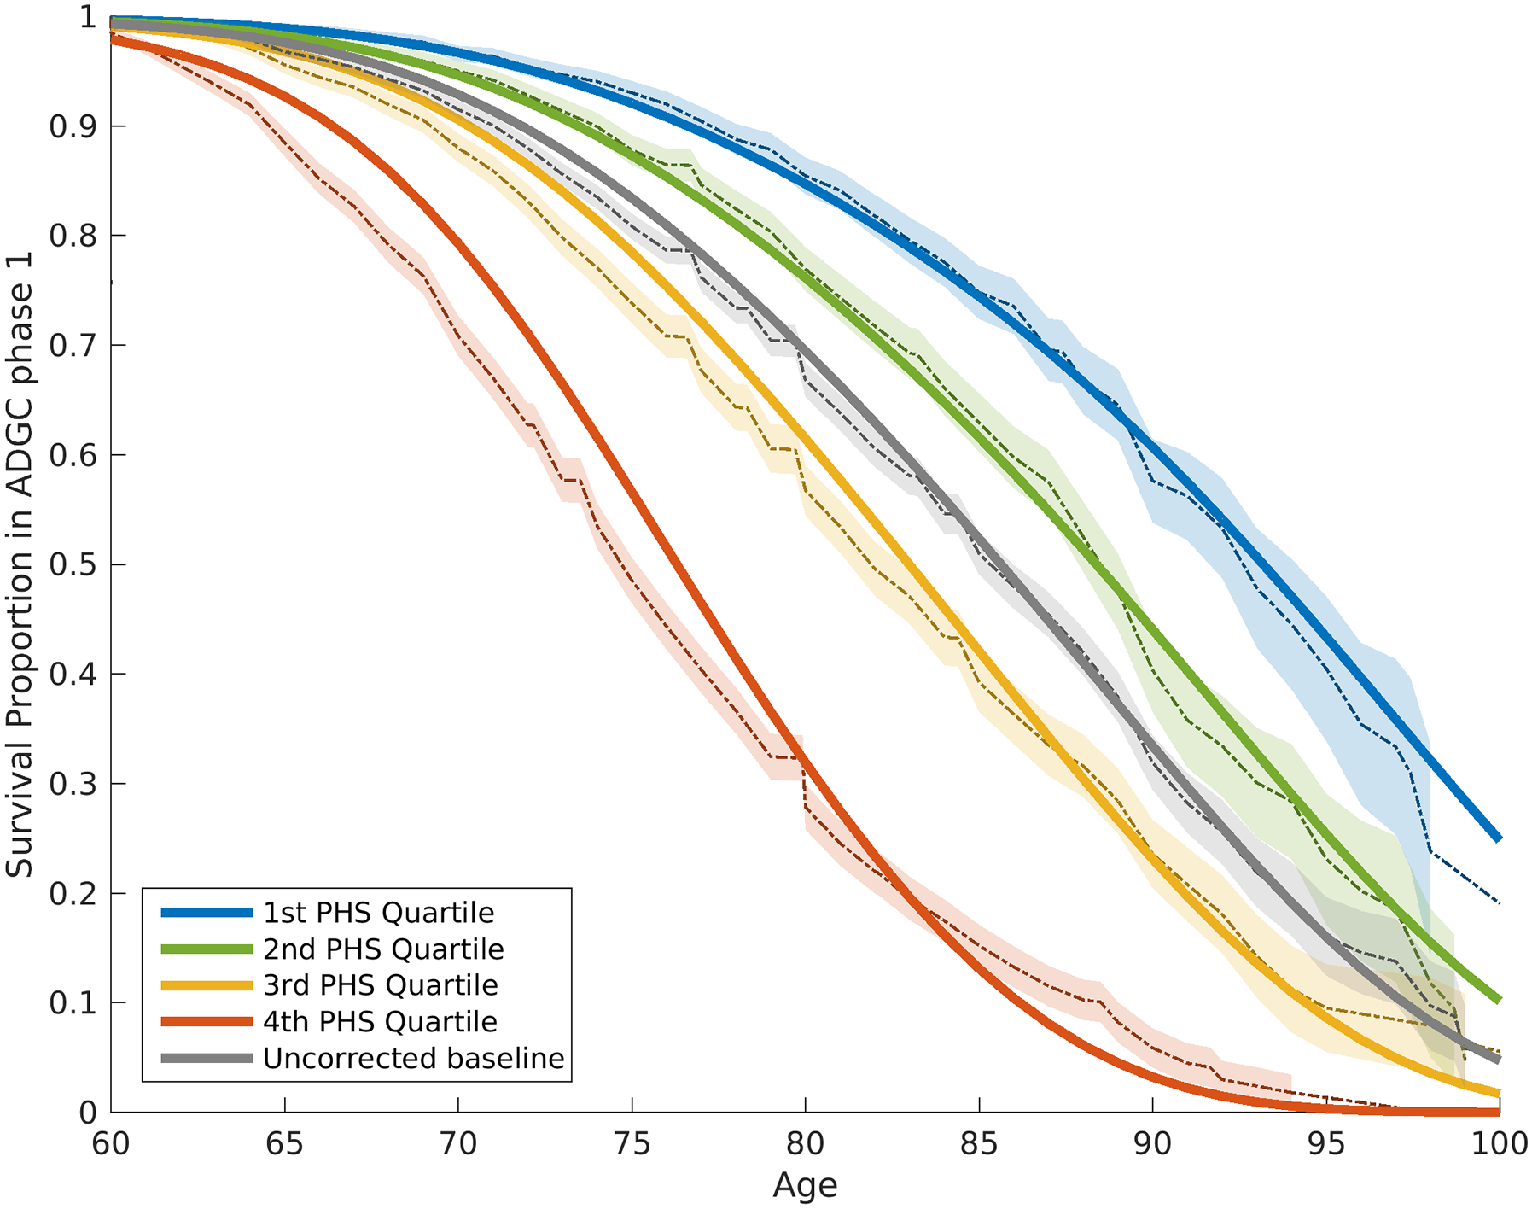
Survival analyses in AD
ADGC (17,008 AD cases and 37,154 controls)
– 28 SNPs IGAP, Cox forward regression model
Desikan, Fan et al. PLoS Med 2017

Slide 13
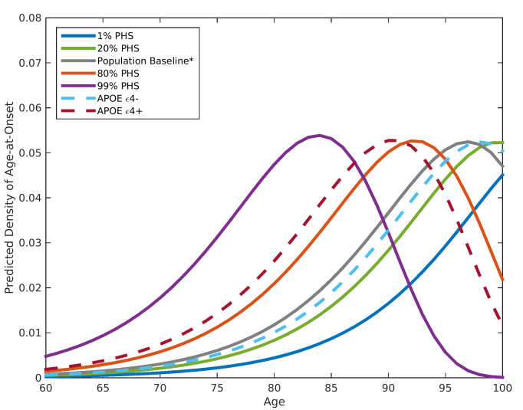
Probability density of AD age of onset
PHS modifies peak age of AD onset
Desikan, Fan et al. PLoS Med 2017

Slide 14
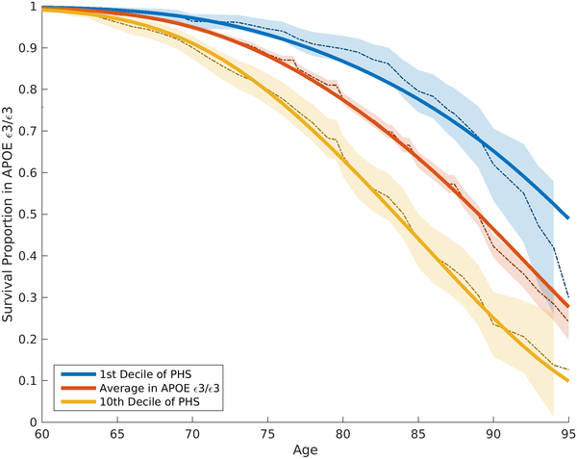
Polygenic prediction beyond APOE
PHS modifies age of AD onset beyond APOE
Desikan, Fan et al. PLoS Med 2017
Notes:
To quantify the additional prediction provided by polygenic information beyond APOE, we evaluated how the PHS modulates age of AD onset in APOE ε3/3 individuals. Among these individuals, we found that age of AD onset can vary by more than 10 y, depending on polygenic risk. For example, for an APOE ε3/3 individual in the tenth decile (top 10%) of the PHS, at 50% risk for meeting clinical criteria for AD diagnosis, the expected age of developing AD is approximately 84 y (Fig 2); however, for an APOE ε3/3 individual in the first decile (bottom 10%) of the PHS, the expected age of developing AD is approximately 95 y (Fig 2). The hazard ratio comparing the tenth decile to the first decile is 3.34 (95% CI 2.62–4.24, log rank test p = 1.0 × 10⁻²²). Similarly, we also evaluated the relationship between the PHS and the different APOE alleles (ε2/3/4) (first figure in S1 Appendix). These findings show that, beyond APOE, the polygenic architecture plays an integral role in affecting AD risk.

Slide 15
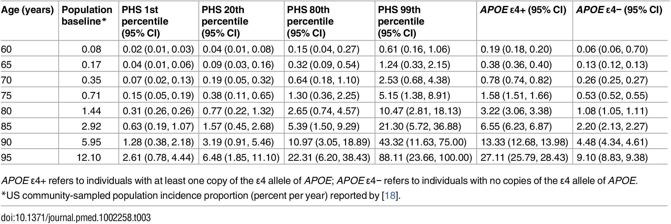
Predicted AD annualized incidence
Desikan, Fan et al. PLoS Med 2017

Slide 16
AD survival curves Nordic samples
  Motazedi J Alzheimers Dis 2022

Slide 17
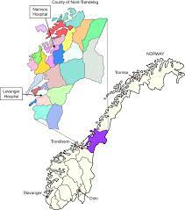
HUNT₄ 70+ Study

Slide 18
Socio-demographic data and test results from the Montreal Cognitive Assessment (MoCA) test (17)
for participants in HUNT4 Trondheim 70+ and HUNT4 70+ in Nord-Trøndelag. SD = standard deviation.
Variable |  | Trondheim (n = 1 719) | Nord-Trøndelag (n = 9 744)
Age in years, mean (SD) |  | 78.6 (7.0) | 78.0 (6.5)
Women, n (%) |  | 993 (57.8) | 5 299 (54.4)
Age group
 | 70–79 years, n (%) | 1 122 (65.3) | 6 616 (68.0)
 | 80–89 years, n (%) | 436 (25.4) | 2 501 (25.7)
 | ≥ 90 years, n (%) | 161 (9.4) | 627 (6.4)
Education level
 | Primary/lower secondary school, n (%) | 290 (16.9) | 2 507 (25.7)
 | Upper secondary school, n (%) | 772 (44.9) | 5 234 (53.7)
 | University/university college, n (%) | 657 (38.2) | 2 003 (20.6)
Site of participation
 | Field station, n (%) | 1 285 (74.8) | 8 412 (86.3)
 | Own home, n (%) | 179 (10.4) | 724 (7.4)
 | Nursing home, n (%) | 255 (14.8) | 608 (6.2)
MoCA test score, mean (SD)¹ |  | 22.9 (4.9) | 22.5 (4.9)

Slide 19
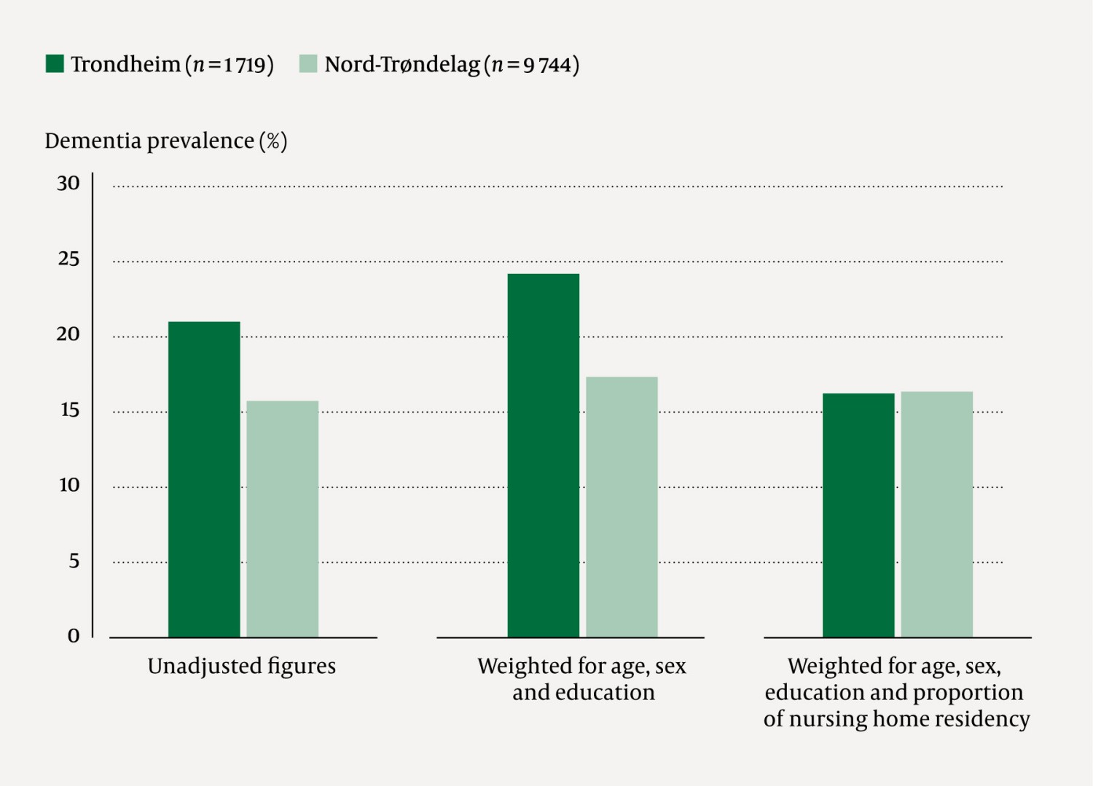
HUNT₄ 70+ Study

Slide 20
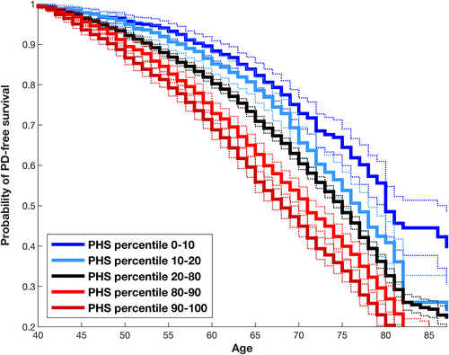
Parkinson’s disease survival curve

Slide 21
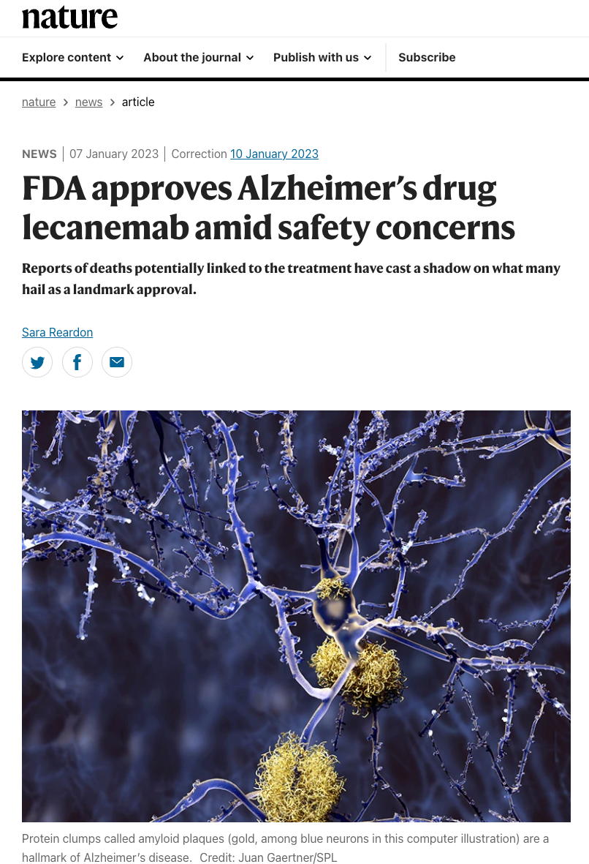
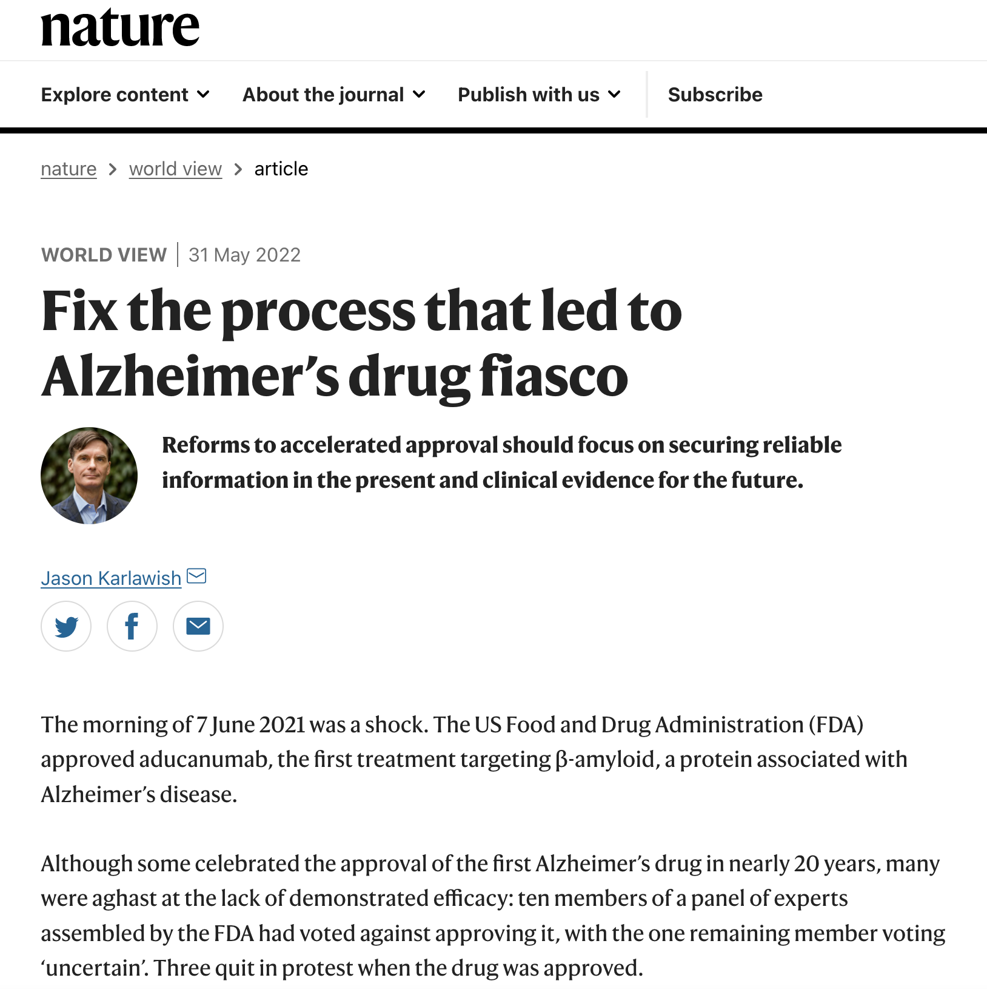

Slide 22
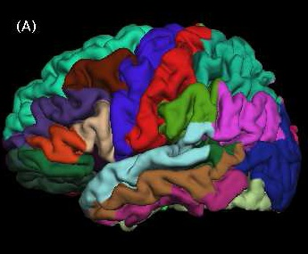
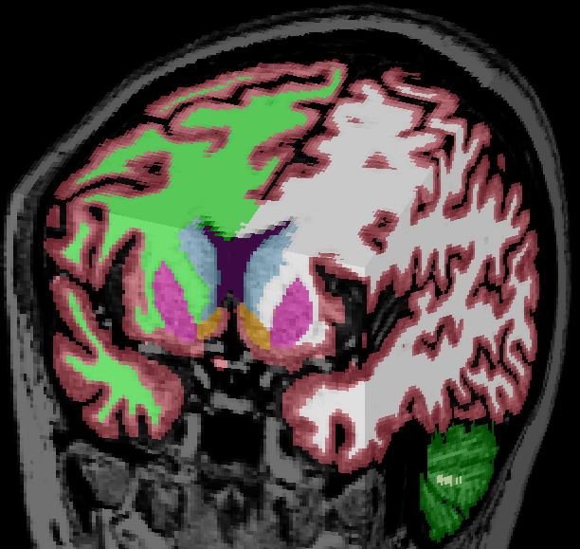
Stratification Memory Clinic
Start treatment before neurodegeneration (AD)
Who should be selected for intervention?
Polygenic Hazard Score (PHS)
Multimodal approach – capture more variation

Slide 23
Memory clinic: who will develop Alzheimer’s?
Polygenic Hazard Score
OR_{80/20} = 3.57

Slide 24
Polygenic Hazard Score and brain MRI
OR_{80/20} = 13.16

Slide 25
Polygenic Hazard Score, brain MRI and cognitive test
OR_{80/20} = 27.03
Notes:
PHS Polygenic Hazard Score, IHS Imaging Hazard Score, AVLT Auditory Verbal Learning test

Slide 26
Enrich clinical trials with MHS – Stratify RCTs
Model Relative sample size
Age 0.713
Age + PHS 0.522
Age + PHS + MRI 0.356
MHS: Age + PHS + MRI + RAVLT 0.333
Reas et al.,2023

Slide 27



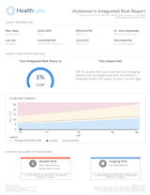
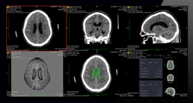
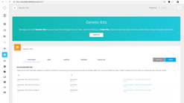






Personalized “Cockpit” for Alzheimer’s disease
Alzheimer’s Polygenic Risk Report
Integrated
Risk Report
Physician Portal
PhysicianPortalTM
CLIA-certified
Genotypes Biomarkers
(Blood sampling)
Cognitive Testing
Radiology AI/ML
Precision Health AS

Slide 28
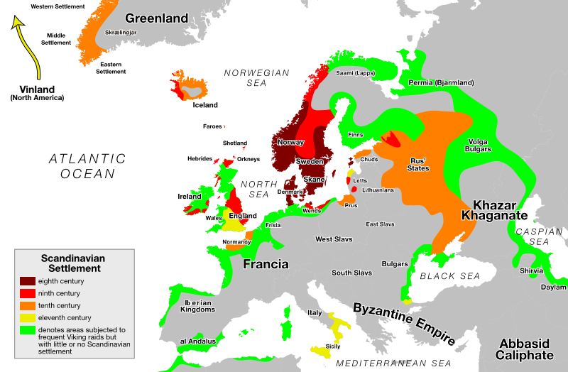
Vikings

Slide 29
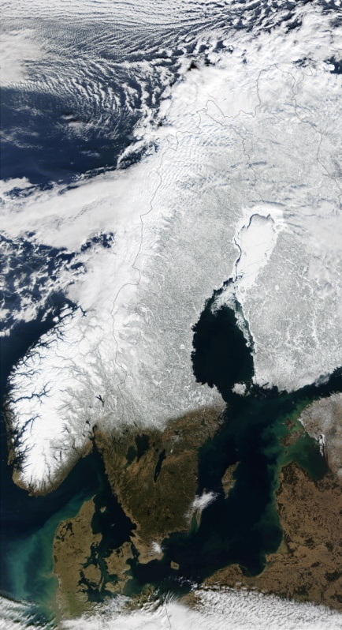
Nordic countries advantages (27 mill)
Personal identifiers
Health registries
Large biobanks
Public health system
Population surveys
Motivated population
=> Integrate Research and Health Care
- training data for Precision Medicine
National Cohorts

Slide 30

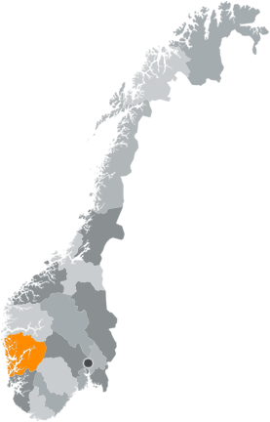
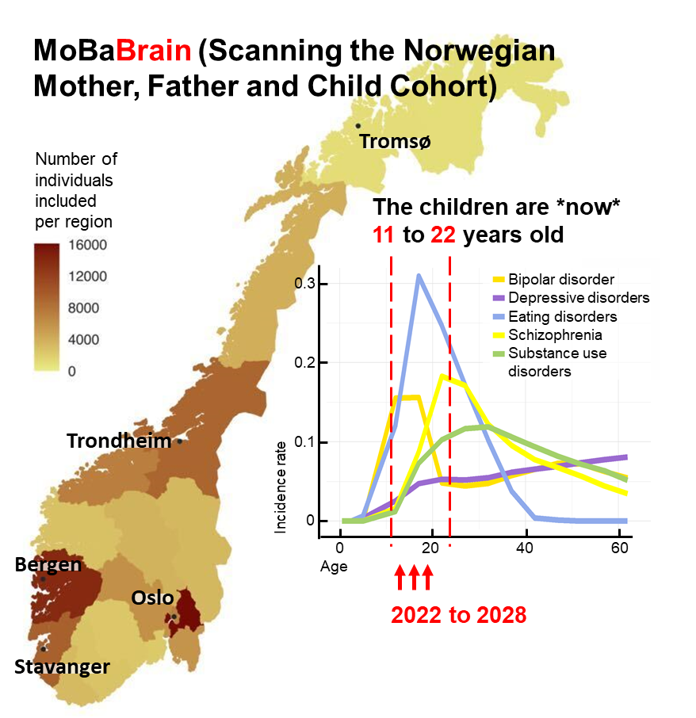



Norwegian population survey samples 400k genotyped

Slide 31


Norwegian approach for G x E studies population cohorts clinical samples
Population Genetics 400k
HUNT (1984 - )
90 000 genotyped
MoBa (1998 - )
240 000 genotyped
Tromsø Study
(1975 – 2017)
35 000 genotyped
HUSK (1996-)
35 000 genotyped
- multi-omic
Health Care Samples
Diagnostics
Treatment stratification
Prediction
Clinical trials
Hospital biobanks
Sequencing
Clinical care
Health data
Health Analysis Platform
with Registry Data
EHR
Norwegian Genomics Consortium
Status by July 2021:
400 000 genotyped
20-45 years of follow-up
repeated screening
With health data and biological sampling
Omics data
Omics data
Genotype-phenotype

Slide 32
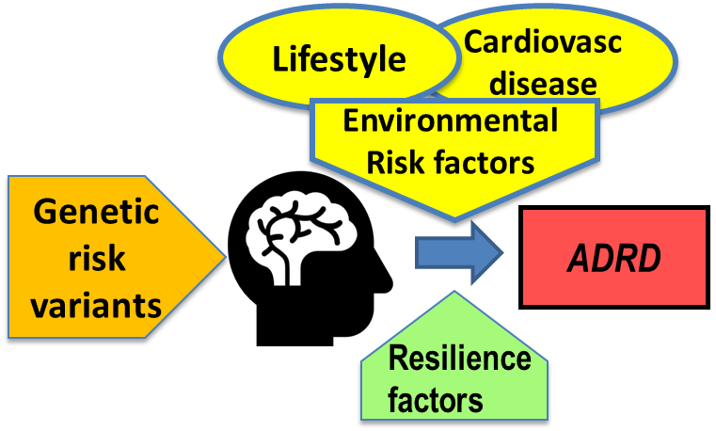
Norway: DemGene Project dementia (25k), AD (n=7k), controls (120k)
Health
Surveys
Registry data
Biobanks
Hospitals,
populations
Hospitals
Registry data

Slide 33
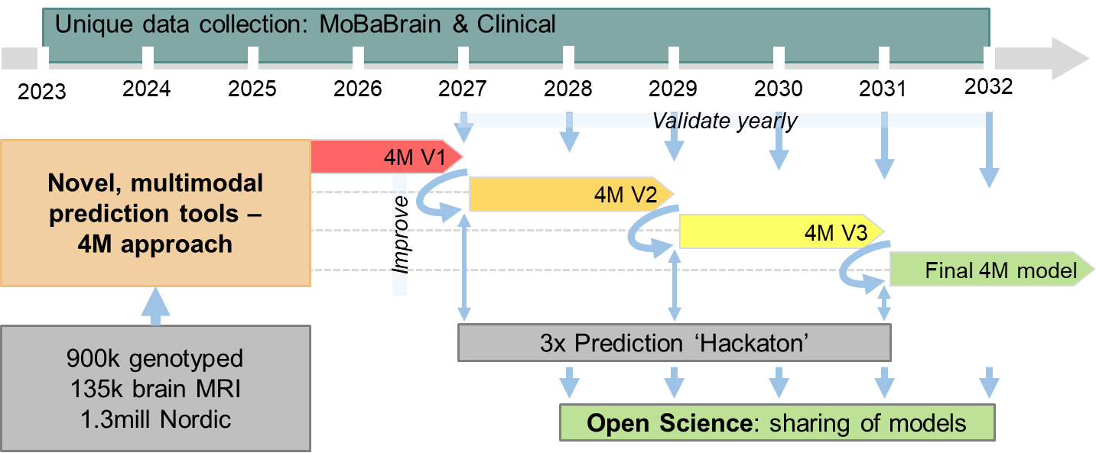
Prediction dementia
Notes:
1 This will ensure we will have enough data and results from Identify and Stratify projects – to develop the first version of the prediction tools (4M) after 3-4 years
2 The performance will be tested with new cases obtained each year from the Health Registries
3 We will constantly improve the methods and share the results and models within an open science framework ----NEW---

Slide 34
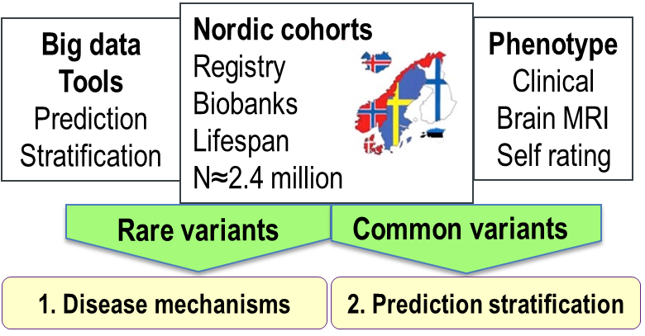
Conclusion
Gene discoveries can have clinical impact in Alzheimer´s disease
  Stratification Memory Clinics, RCTs
  Prediction (future)
Multimodal epidemiology approach
Nordic infrastructure
  Tryggve
  Develop and validate

Slide 35



Acknowledgements
Study participants Funding :
DemGene – Geir Selbæk RCN
UCSD – Anders Dale EU, NIH
PGC, deCODE KG Jebsen
CoMorMent, RealMENT Health Authority
This project has received funding from the European Union’s Horizon 2020 Research and Innovation Programme under Grant agreement No. 964874

